Slide 1
Medical Business WaitTime Tracker through AI
Team Members : KBMK Kangunati Venkatkiran Manvitha Baireddy Marru Saideep Kollu Gopi

Slide 2
Target Market & Value Propositions
Target Market : The Main Target for our project is Business Owners and General Public.
Value Propositions : Dashboard features, Reducing the manual work, Enhanced safety and improve Customer experience.

Slide 3
Main Modules in this project
Human Detection and Count.
Wait Time Analysis
Database
Web Page (To display current stats)

Slide 4
Challenges
Impact on business
AI Live video processing
Manual work requirement

Slide 5
AI Web Solution
Wait time tracker
Live video processing
Exact count and waittime
Customers safety and satisfaction
Increase in sales

Slide 6

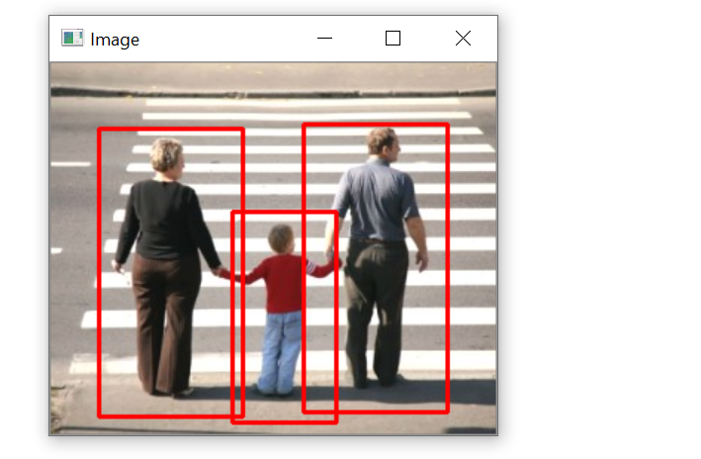
Human Detection from live video
There are a variety of computer applications that identify human body in digital images, like - pedestrian crossing, criminal identification, healthcare and so on. The detection program allows us to identify and locate objects. It is very important in area of research, where the detected object can be count, accurately determined.

Slide 7
Key Features and Justification
AI Live Video Processing
Accuracy
Open Source
Dashboard
Data Privacy

Slide 8
Functionality and workflow
Business owners have access to web application, where they could track the number of people shopping. Thus, improving the efficiency or the workloads of the employees.
Selling our AI web application to business owners would make profits.
Dashboard Advertising on the dashboard to generate profits for the business owners.
improvements by providing review system and ratings.

Slide 9
Business Model
Business owners have access to web application, where they could track the number of people shopping. Thus, improving the efficiency or the workloads of the employees.
Selling our AI web application to business owners would make profits.
Advertising on the dashboard to increase customer base and generate profits for the businesses.

Slide 10
Team Members and Contributions
Team Members:
Kangunati Venkatkiran - Business Logic Implmentation
Manvitha Baireddy - UI Implementaion & Deployment Marru Saideep - Github Setup, Marketing and Management
Kollu Gopi - UI Implementation & Testing

Slide 11
Github Link
https://github.com/KKMBTeam/waittime-tracker

